Slide 1
Computer Organization
TOPIC 2.0 – Computer organization
TOPIC 2
2.1.6 – 2.1.8: Operating Systems and Application Systems

Slide 2
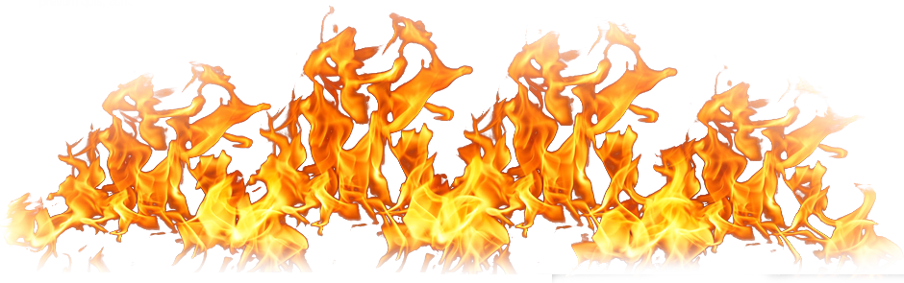
REVIEW REVIEW REVIEW REVIEW REVIEW REVIEW
THE WARM-UP QUESTION
List the pros and cons of using a HDD versus a SSD

Slide 3
REVIEW REVIEW REVIEW REVIEW REVIEW REVIEW
THE WARM-UP ANSWER
HDD: Slower, cheaper, more durable
SSD: Faster, more expensive, less durable

Slide 4
TOPIC 2.1.6 – OPERATING SYSTEMS
Operating systems
The operating system (OS) is a set of software that controls the computer’s hardware resources
Intermediary between software (apps) and hardware (computer)
The user interacts with the app, which then interacts with the operating system, which then interacts with the hardware

Slide 5
TOPIC 2.1.6 – OPERATING SYSTEMS
User Control
Application (App)
Operating System
Computer Hardware

Slide 6
TOPIC 2.1.6 – OPERATING SYSTEMS
OS JOBS
Operating systems are in control of
Peripheral communication
Memory management
Resource monitoring and multitasking
Networking
Disk/Data Access and Management
Security

Slide 7
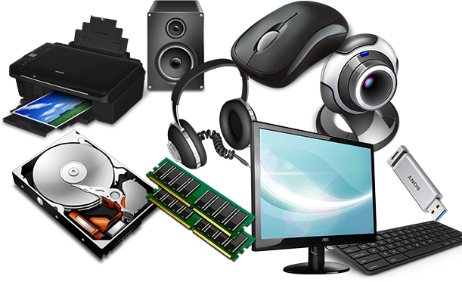
TOPIC 2.1.6 – OPERATING SYSTEMS
Peripheral communication
Peripherals – hardware components residing outside of the computer
Mice, Keyboards, Monitors, etc.
Operating System communicates directly with hardware, providing an interface between hardware devices and applications
We can use hardware without fiddling with the specific implementation of it

Slide 8
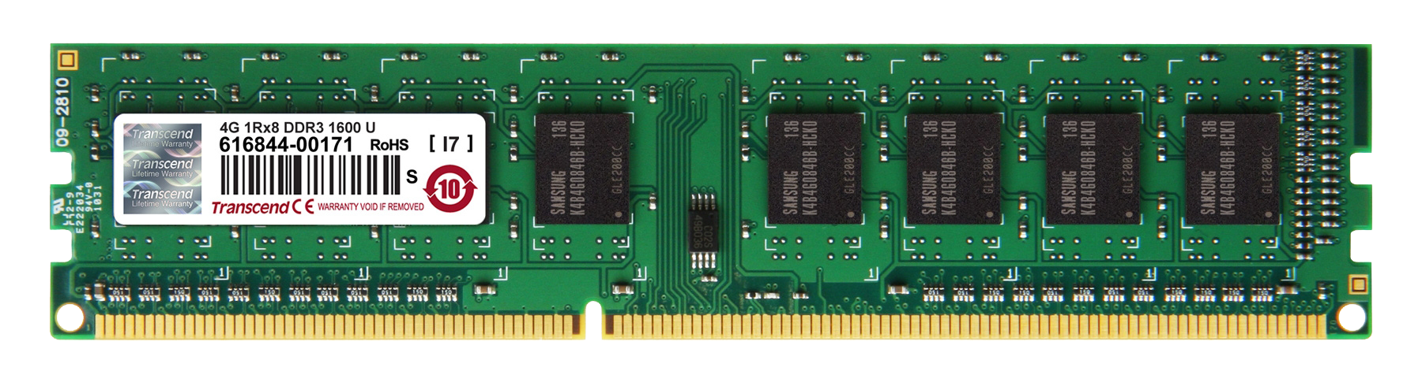
TOPIC 2.1.6 – OPERATING SYSTEMS
Memory management
The OS controls all the memory available to the system
How it is used by applications
Ensures that apps don’t interfere with each other’s places in memory
This could make one or both of the apps stop functioning, possibly overwriting important data

Slide 9
TOPIC 2.1.6 – OPERATING SYSTEMS
Resource monitoring/multitasking
Each app running on a computer takes resources (CPU, Memory, etc.)
OS allocates resources so each app can run as effectively as possible
OS runs multiple apps in sequence, making it appear as though they run simultaneously
OS manages applications sharing the CPU to do this
This is known as multitasking
Covered more in depth in Unit 6

Slide 10

TOPIC 2.1.6 – OPERATING SYSTEMS
Networking
OS controls connections and interactions with networks of other computer systems
Allows for sharing of resources (files/printers)
Essential to modern computers, be it LAN or Internet
OS acts as intermediary between applications and networks

Slide 11
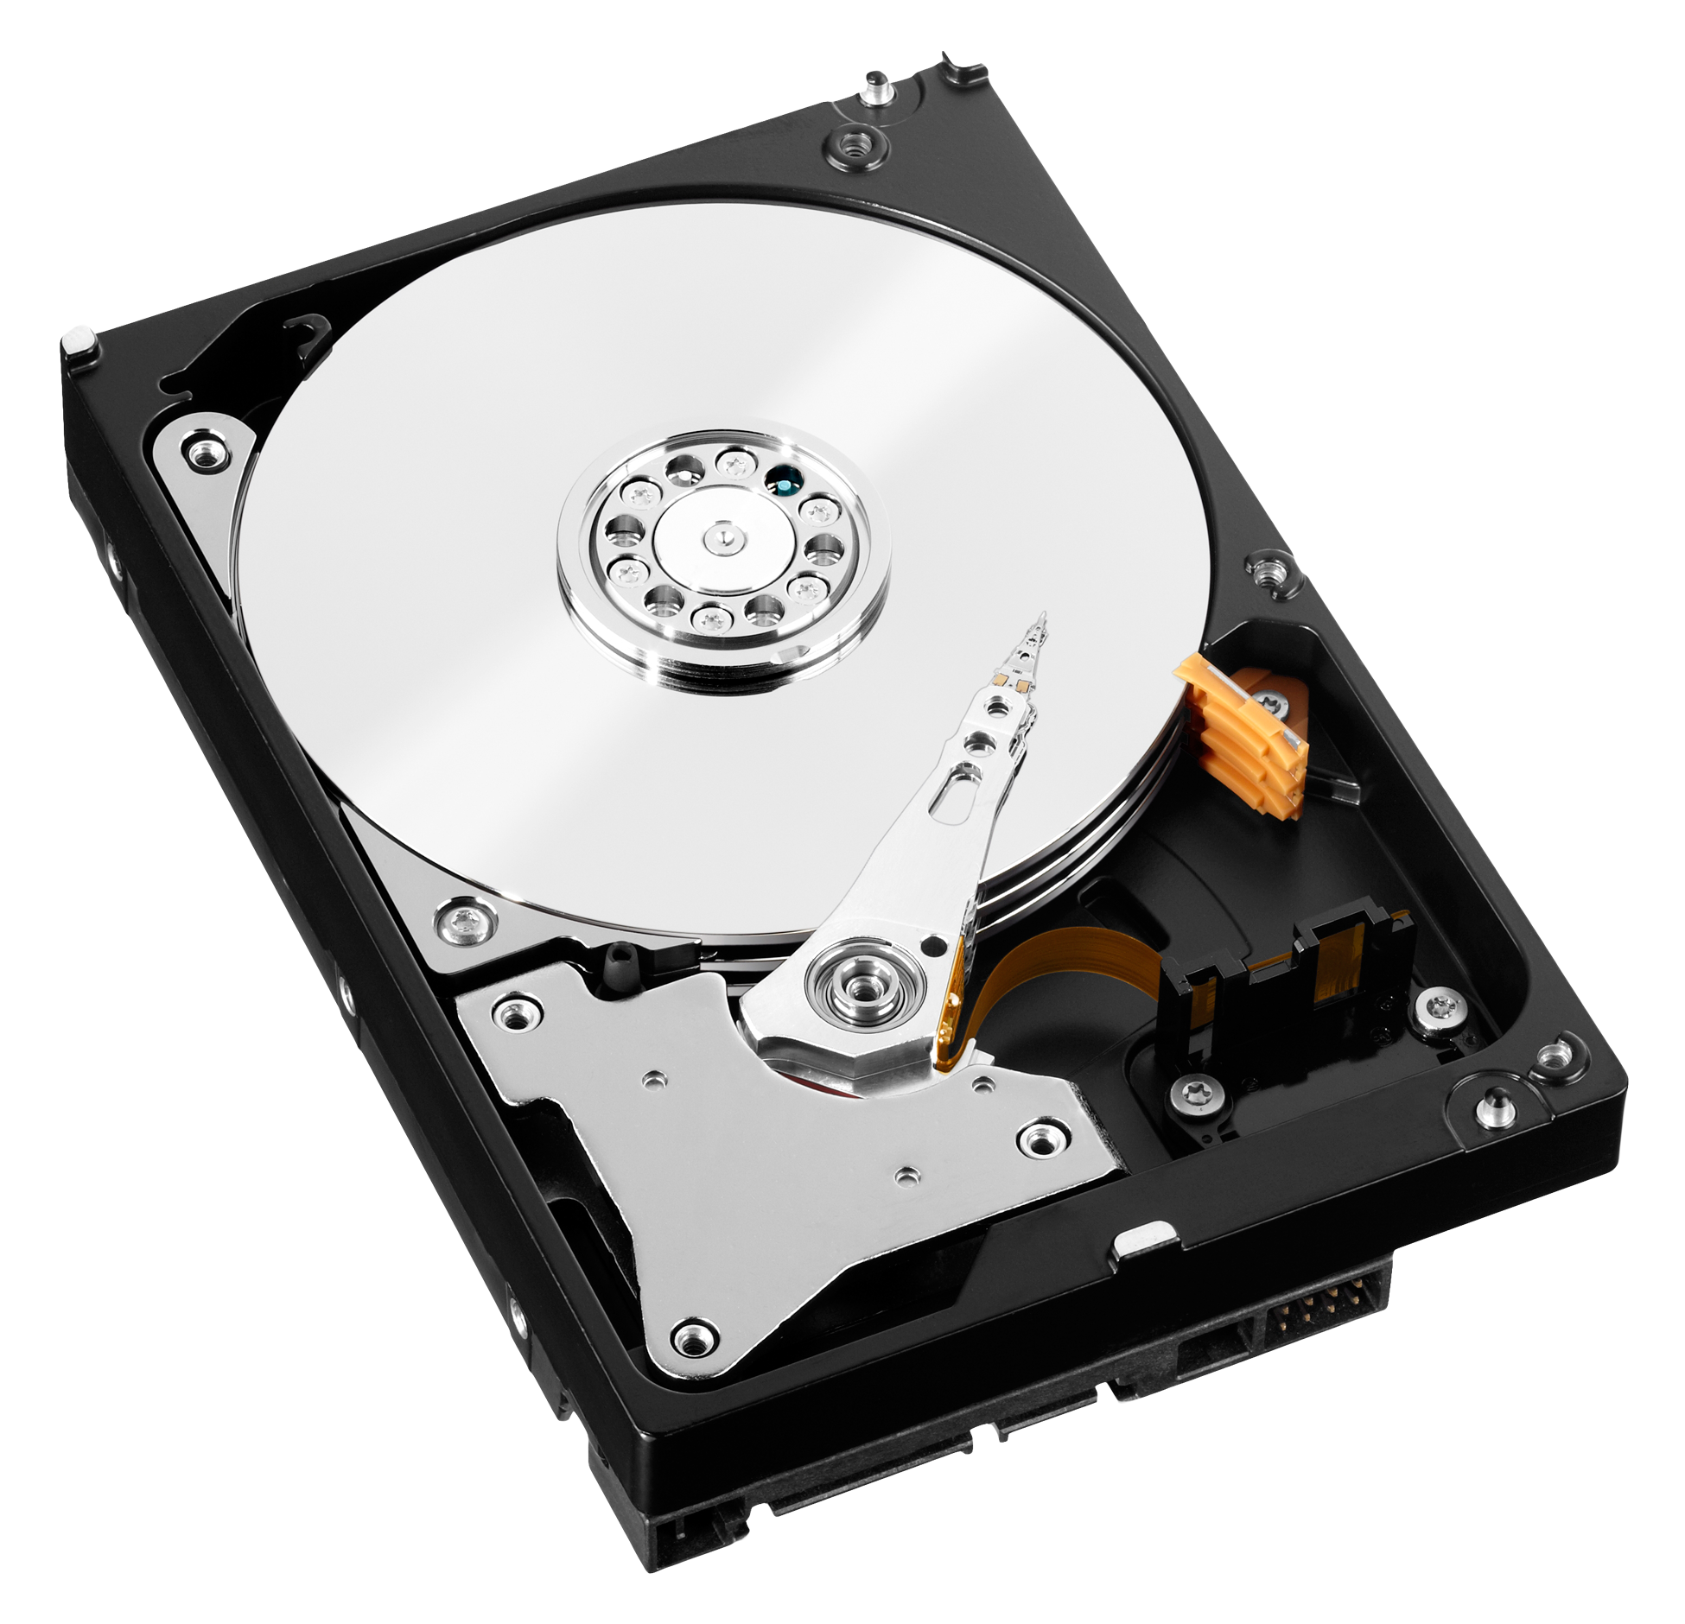
TOPIC 2.1.6 – OPERATING SYSTEMS
Disk access/Data
Data is stored in files and operating system controls this writing
OS must provide reliable and fast access to the disk
OS keeps track of files, as well as what files each program is using
This way, no program overwrites another program’s files
OS coordinates transfer of data files

Slide 12
TOPIC 2.1.6 – OPERATING SYSTEMS
Disk access/Data
Think of the Operating System as the wait staff at a restaurant
Guide data (customer) from hard drive to correct spot in computer (table)
Take care of customer throughout process
Handle all of the operations to get the customer out, such as getting checks and to-go boxes

Slide 13

TOPIC 2.1.6 – OPERATING SYSTEMS
Security
Most common way is to check that user is validated (password)
Generate log files about what activity happens on the computer
Reading, Writing, Deleting files, changing settings, etc.
This allows unauthorized actions to be traced
Built-in antivirus capabilities to detect malicious files

Slide 14
TOPIC 2.1.7 – SOFTWARE APPLICATIONS
Applications
Computer systems are designed to run lots of different types of programs
The software that the OS runs isn’t built it
It is installed by the user and runs on the OS as a platform
Examples:
Word Processors
Spreadsheets
DBMS
Web Browsers
Email Clients
Design Software

Slide 15

TOPIC 2.1.7 – SOFTWARE APPLICATIONS
Word processors
Word processors are used to create documents
Composing, editing, formatting, & printing documents
One of the most common types of programs installed on any computer system
Microsoft Word, LibreOffice, OpenOffice

Slide 16
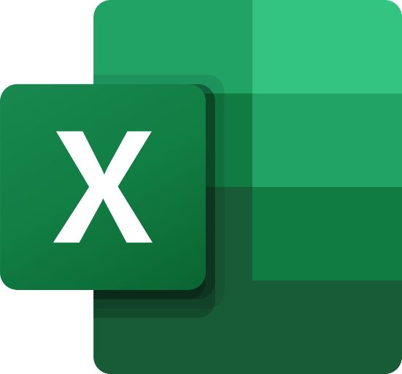
TOPIC 2.1.7 – SOFTWARE APPLICATIONS
Spreadsheets
Organization and analysis of data.
Data represented as cells that can contain numbers, text, results of formulas, etc.
Allow for use of common formulas
Support essential financial and statistics operations
Examples: Excel, OpenOffice Calc

Slide 17
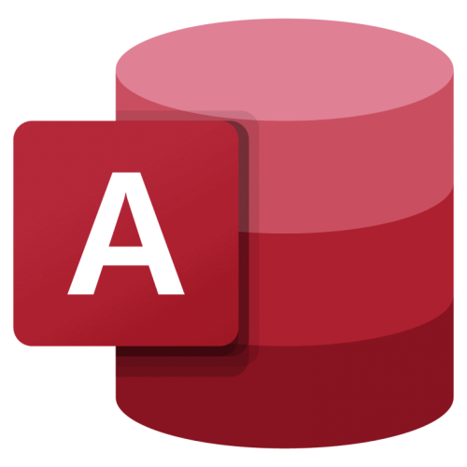
TOPIC 2.1.7 – SOFTWARE APPLICATIONS
DBMS
Database Management Systems (DBMS)
Manages databases and is designed to provide interface between users and databases
Structured data items in a table
Each record contains related data in a tuple, with a primary key that uniquely identifies that tuple
Examples: Microsoft Access, MySQL Database

Slide 18

TOPIC 2.1.7 – SOFTWARE APPLICATIONS
Web browser
Program to access, retrieve, and present content on the World Wide Web
Web browser uses a URL to connect to the appropriate web servers to get wanted information
Web servers send requested information back to client machines
Examples: Microsoft Edge, Google Chrome, Firefox, Safari

Slide 19

TOPIC 2.1.7 – SOFTWARE APPLICATIONS
Email
Email allows for exchange of messages
Email consists of envelope, header, and body, and is transferred using the Simple Mail Transfer Protocol (SMTP).
Header contains info about sender and recipient, subject field, and date/time stamp
Body contains actual message
Programs can be web based (websites) or actual programs
Examples: Microsoft Outlook, Gmail

Slide 20


TOPIC 2.1.7 – SOFTWARE APPLICATIONS
Design software
CAD software can help engineers create and modify designs.
Used for automotive, architecture, and engineering fields
Examples: AutoCAD and Solid Works
Graphic processing software can be used to edit visual images on computers
Used by artists and graphic designers
Examples: Photoshop, InDesign

Slide 21
TOPIC 2.1.8 – APPLICATION FEATURES
CLIs
Old programs were created using Command Line Interfaces (CLIs)
These are text-based interfaces that you interact with using a keyboard and not a mouse
Think of what you see when you run your own Python program

Slide 22
TOPIC 2.1.8 – APPLICATION FEATURES
GUIS
Software programs typically include a Graphical User Interface (GUI)
GUIs typically contain graphical icons, visual indicators, toolbars, menus, and dialogue boxes
This allows for more smooth and direct manipulation of the graphical elements

Slide 23
TOPIC 2.1.8 – APPLICATION FEATURES
cli vs GUI
Command Line Interfaces | Graphical User Interfaces
Easier to implement by programmer Less memory to run Can be run on systems without a graphical monitor Quicker to type commands instead of using a mouse (for experienced users) | No need to remember specific commands Users can use icons for commands Commands grouped in menus and toolbars
Users must remember specific commands Harder for new users | More complex to implement as a programmer Requires more memory Requires a graphical monitor and mouse

Slide 24
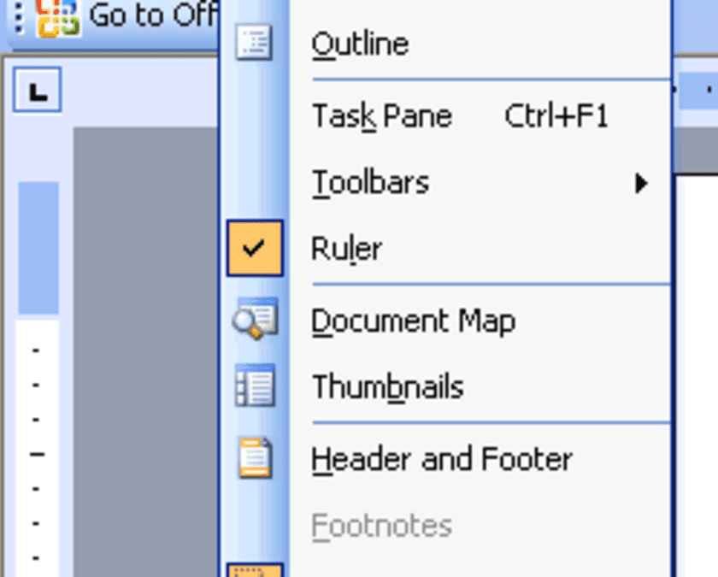
TOPIC 2.1.8 – APPLICATION FEATURES
GUI ELEMENTS
Toolbars, Menus, Dialogue boxes
Toolbars hold icons, buttons, and menus
Menus hold a list of commands that can be chosen by the user
Dialogue boxes are used to communicate information to the user and let them pick options

Slide 25
TOPIC 2.1.8 – APPLICATION FEATURES
GUI ELEMENTS
GUIs are designed using the acronym WIMP
Windows, Icons, Menus, Pointers
GUIs are common and can be found in almost all software applications
Lots of Windows apps are developed using the .NET framework, which means they have similar GUIs
Other companies will have their own GUI design scheme (such as Adobe or Apple)
Maintaining consistency between apps makes them easier to use (usability)

Slide 26
TOPIC 2.1.8 – APPLICATION FEATURES
GUI ELEMENTS
This GUI is often provided as a framework from the Operating System
Like the .NET framework
Programmer only needs to say that they exist
This saves time for the programmer and improves consistency between applications

Slide 27
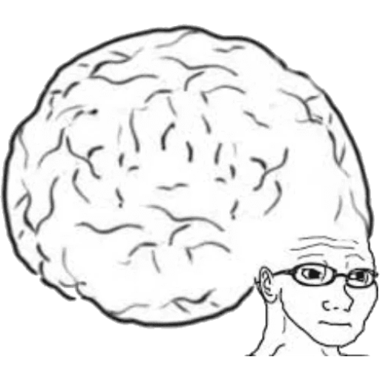
TOPIC 2.0 – computer organization
Vocab to remember
CLI
GUI
Operating Systems
Application Systems

